Slide 2
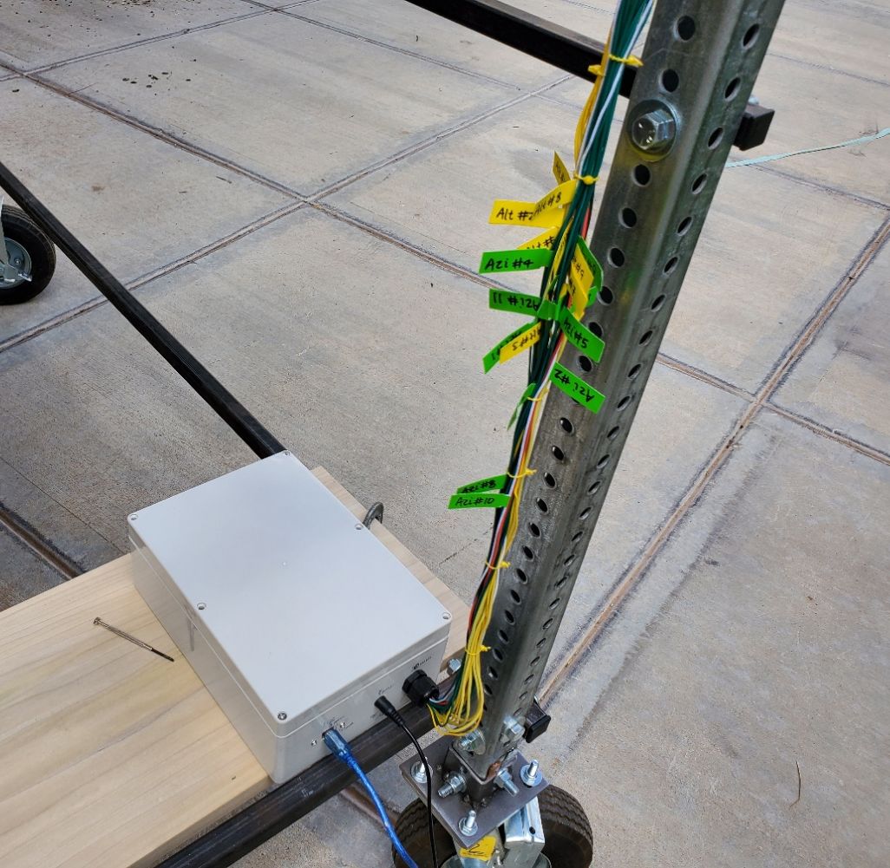
Electrical Wiring
Labels on all wires
Labels on all wires
Control Box for all components
5V Power
USB

